Slide 1

SMART SYSTEM CONTROL WITH VOICE COMMAND USING FIREBASE

Slide 2

SMART SYSTEM CONTROL WITH VOICE COMMAND USING FIREBASE
GODUGUCHINTA SANDEEP - 19BF1A0553
EREPALLI REKHASREE - 19BF1A0548
CHEEPATI NITHIN KUMAR REDDY - 19BF1A0533
BOYAPATI RAHUL - 19BF1A0523
Under the Guidance of
S. Mrudula, M.Tech
DEPARTMENT OF COMPUTER SCIENCE AND ENGINEERING,
SRI VENKATESWARA COLLEGE OF ENGINEERING Karakambadi Road,
Tirupati - 517507
2023

Slide 3
CONTENTS
Abstract
Introduction
Literature Survey
System Requirements
Existing System
Proposed System
Architecture
Module Description
Project Design
Project Code
Code Testing
Conclusion
References

Slide 4
LITERATURE SURVEY
Lingyan Bi proposed a novel method to Design an Android based Remote Control System e with JNI Interface for providing convenience for the user.
Michael Spreitzen barth proposed analysis-based Smartphone Mobile Malware for forensic Analyses.
Xinfang Lee, presented a novel Android based Forensic System.
Enck, W proposed a secure Android Remote controlling mechanism for performing secure transaction form the Remote location.
T. Richardson proposed a novel method of Internet based Android application to demonstrate working of Internet Computing.

Slide 5
ABSTRACT
This project presents a system for controlling a computer system remotely using voice commands. The system uses a mobile interface built on Scratch, which is capable of capturing voice commands and transmitting them to a remote computer via Firebase. The computer system is programmed using Python to execute the commands received from the mobile interface. The proposed system is an improvement over traditional socket-based connections that are limited to a specific range. The system allows for remote control of a computer system from anywhere in the world. This project presents the implementation of the system, experimental results, evaluation metrics, and future work.

Slide 6
INTRODUCTION
Nowadays, PC’s, Laptop’s and all other electronic gadgets are inseparable part of our everyday life. Personal computers are not any longer meant for working purpose, but more and more used for entertainment in people’s spare time. This is also applicable to the mobiles, which have transformed into multifunctional devices with almost same features as computer have.
Knowingly, or unknowingly, personal assistants have become an integral part of our lives these days. It is because of all the features and ease of use they provide. Personal Assistants are also capable of automating some day-to-day tasks. User is expected just to give a voice command, and the assistant will take care of the rest. Features like, making calls, writing messages, taking photographs, storing to-dos on the go, browsing internet etc., are offered by personal assistants.

Slide 7
SYSTEM REQUIREMENTS
Software Requirements
Operating System : Windows 10, Android
Ide : PyCharm
Database : Firebase
Coding : Python, Scratch
Libraries used : PyAutoGUI,
PyWhatKit, Psutil
Hardware requirements
Processor : Intel i5 or above
Ram : Minimum 225mb or more
Hard disk : Minimum 2gb of space
Input Device : Microphone
Output device : Monitor Screen

Slide 8
EXISTING SYSTEM
Access Control is an Android Application that works on the concepts of wireless socket programming. This application is to provide the user with a remote for his/her PC in the form of an android device. Using this application, the user may perform various actions on his PC such as controlling the mouse movement and operations, sliding through various PPT slides, managing media, entering text on any application on their PC, from a reasonable distance, all just with the help of their android device. For this application to work, the PC and the given android device need only be connected to a common network.

Slide 9
DRAWBACKS OF EXISTING SYSTEM
Security risks: Since the application involves wireless socket programming, there may be potential security risks associated with its use. For example, if the common network is not secure, it could allow unauthorized access to the PC by malicious actors.
Compatibility issues: The application may not be compatible with all versions of Android devices or PCs, which could limit its usefulness.
Limited functionality: The application may not offer the full range of capabilities that a user needs to control their PC remotely, which could limit its usefulness for certain tasks.
Learning curve: The user may need to spend some time learning how to use the application effectively, which could be a drawback for those who prefer a more intuitive user experience.

Slide 10
PROPOSED SYSTEM
Proposing a technology that is very useful for people for their crucial work to be accomplished in time. The mobiles accessing PC can be achieved. Proposed system also minimizes the chances of errors because separate options are provided for different tasks. Internet connection is required for mobile and computer as well. Since the mobile device and laptop might both be on different networks, there is no need for the same network in this case.

Slide 11
ADVANTAGES OF PROPOSED SYSTEM
Ease of use: The system is designed to be easy to use, with a mobile interface built on Scratch that can capture voice commands.
Flexibility: The system is not limited by range, unlike traditional socket-based connections. This means that it can be used to control a computer system from anywhere in the world, as long as there is an internet connection.
Convenience: The ability to control a computer system remotely using voice commands can be more convenient than using a traditional keyboard and mouse.
Potential for future development: The proposed system presents the implementation and outlines future work, suggesting that the system has potential for further development and refinement.

Slide 12
APPLICATIONS OF PROPOSED SYSTEM
Controlling a computer system remotely using voice commands has several potential applications, including:
Assistive technology: The system could be used as assistive technology for people with disabilities or mobility issues, allowing them to control their computer systems more easily and independently.
Remote work: The system could be used for remote work, allowing users to control their work computers from home or other remote locations.
Home automation: The system could be used for home automation, allowing users to control their home computers and other connected devices using voice commands from anywhere in the world.
Education: The system could be used for educational purposes, allowing teachers to control their classroom computers from anywhere in the room.

Slide 13
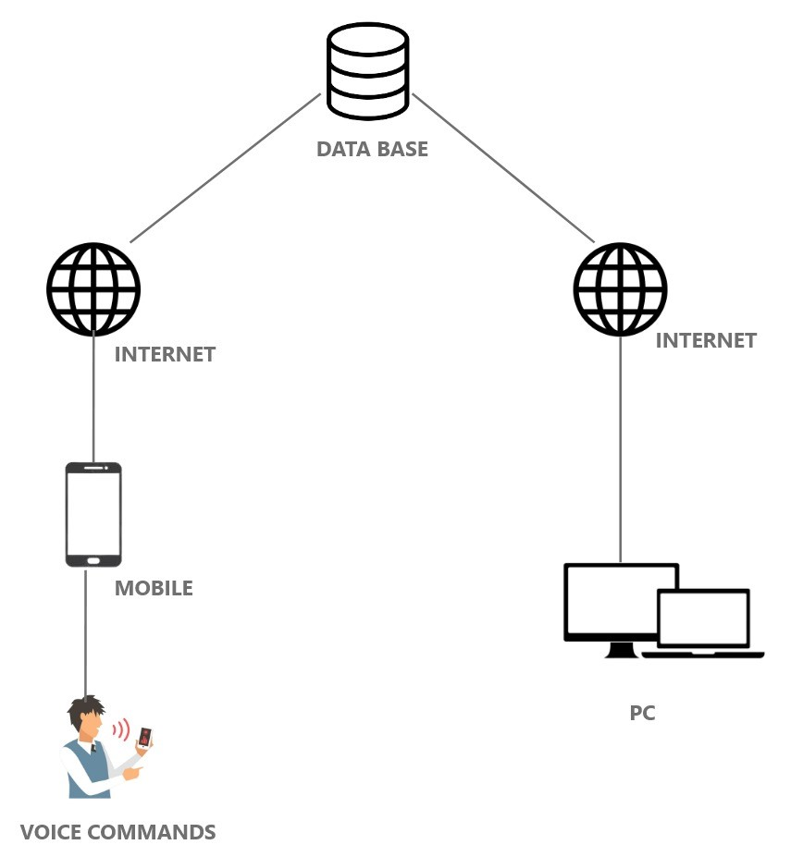
ARCHITECTURE

Slide 14
MODULE DESCRIPTION
The Android application is mainly divided into 3 modules:
1.making user interface using scratch
2.taking voice commands from user
3.convert voice commands into text and store it in database(firebase)
Server application is mainly divided into 4 modules:
1.import Necessary Libraries.
2.connection establish with user application and database.
3.retrive user commands from database.
4.execute these commands

Slide 15
MODULE DESCRIPTION CONT…
Making user interface using scratch:
Using Scratch create an application for user which can take voice commands from user and convert it into text store it on firebase for the further assistance when you click on the Jarvis button it calls the speech recognition and take the voice command from the user and store it on firebase.
Taking voice commands from user:
For the further assistance when you click on the Jarvis button it calls the speech recognition and take the voice command from the user.
Convert voice commands into text and store it database(firebase):
After receiving voice commands from user convert these commands into the text then it will be stored into database for the further use.

Slide 16
MODULE DESCRIPTION CONT…
Import necessary libraries:
In this module initially we need to import all the necessary libraries which are required for building the model. Here we try to use all the libraries which are used to convert the data into meaningful manner. Here the data is divided into numerical values which are easily identified by the system; hence we try to import NumPy module and for plotting the data in graphs and charts we used marplot library.
Connection establishes with user and database:
In this module establish connection between the server and user using firebase. It uses NoSQL for the database for the storage of data.

Slide 17
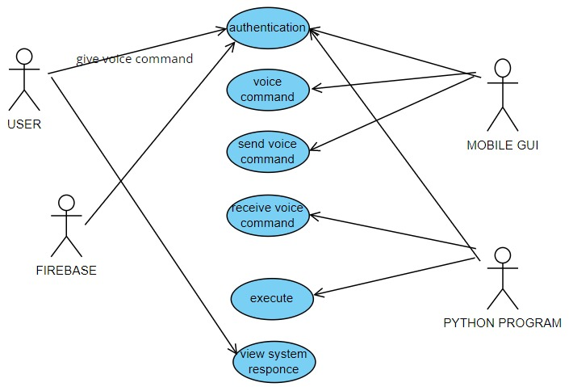
PROJECT DESIGN
Use Case Diagram
A use case diagram in the Unified Modeling Language (UML) is a type of behavioral diagram defined by and created from a Use-case analysis.
Actors: User, Mobile GUI, Python Program, Firebase
Use Cases: Authentication, Voice Command, Send Voice Command, Receive Voice Command, Execute, View System Response

Slide 18
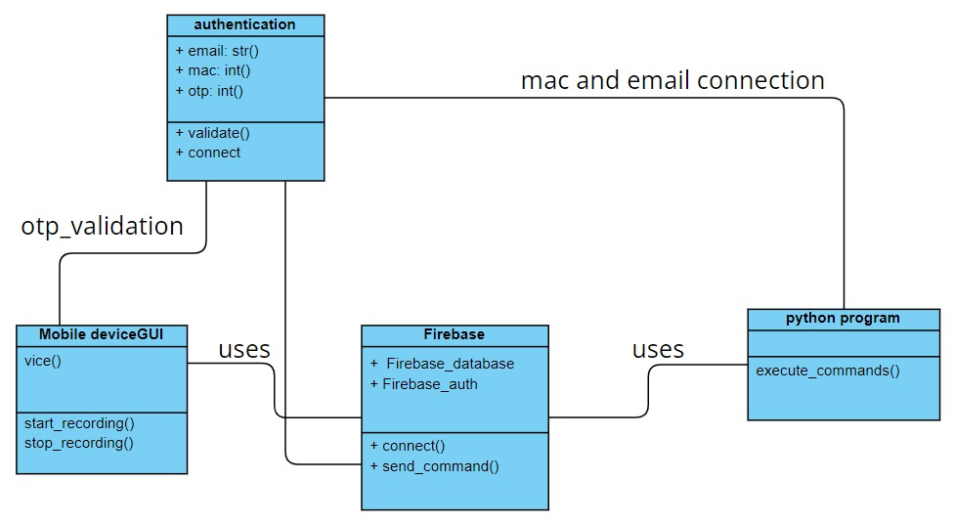
PROJECT DESIGN CONT…
Class Diagram
A class diagram in the Unified Modeling Language (UML) is a type of static structure diagram that describes the structure of a system by showing the system's classes, their attributes, methods, and the relationships among the classes.
Classes: Authentication, Mobile Device GUI, Firebase, Python Program

Slide 19
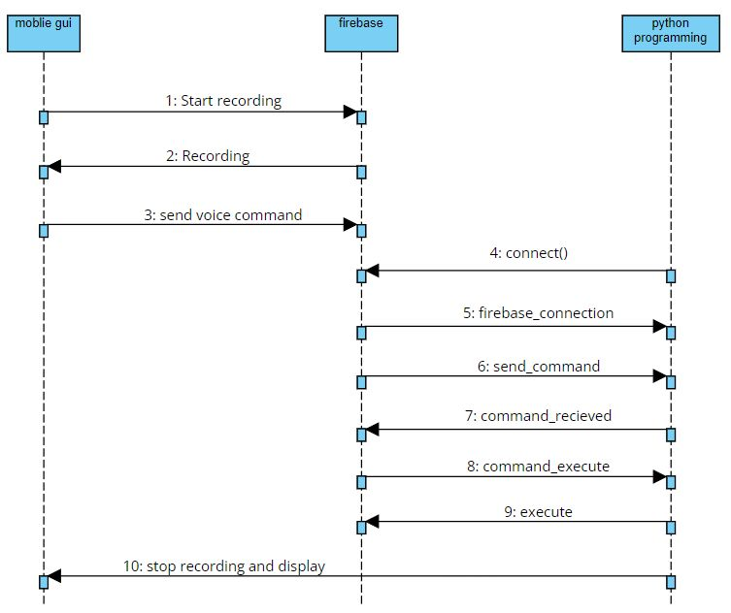
PROJECT DESIGN CONT…
Sequence Diagram
A sequence diagram in Unified Modeling Language (UML) is a kind of interaction diagram that shows how processes operate with one another and in what order.

Slide 20
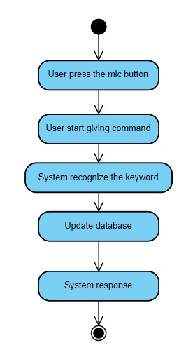
PROJECT DESIGN CONT…
Activity Diagram
An activity diagram illustrates the flow of activities or actions within a system or a process. It is often used to model business processes, software workflows, and other complex systems.
Each activity is represented by a rounded rectangle, and the arrows indicate the flow of the process.

Slide 21
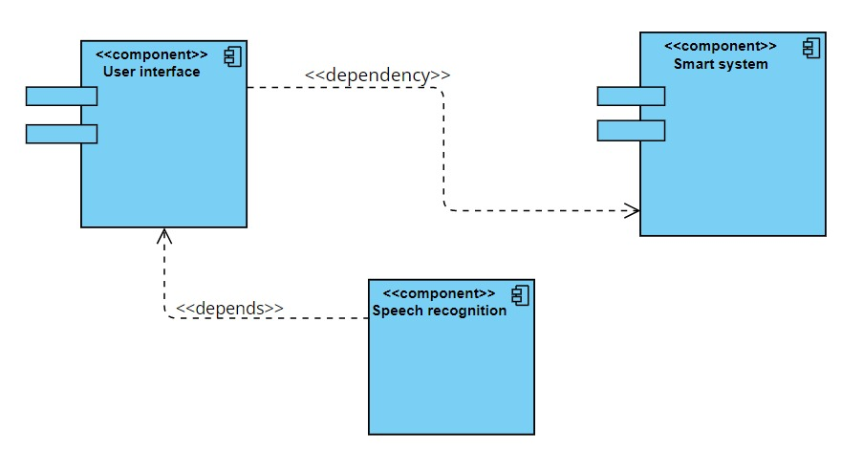
PROJECT DESIGN CONT…
Component Diagram
A component diagram shows the dependencies, relationships, and connections between the components of a system. It is used to represent the architecture of a system in terms of its individual components and their interactions.

Slide 22
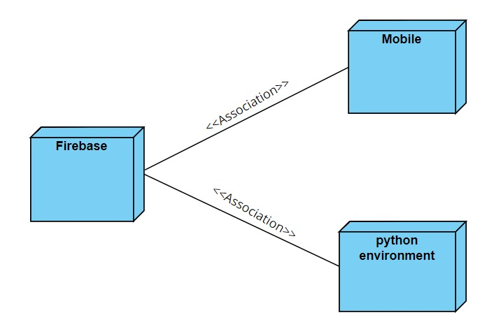
PROJECT DESIGN CONT…
Deployment Diagram
Deployment diagram represents the deployment view of a system. It is related to the component diagram. Because the components are deployed using the deployment diagrams. A deployment diagram consists of nodes. Nodes are nothing but physical hardware used to deploy the application.

Slide 23
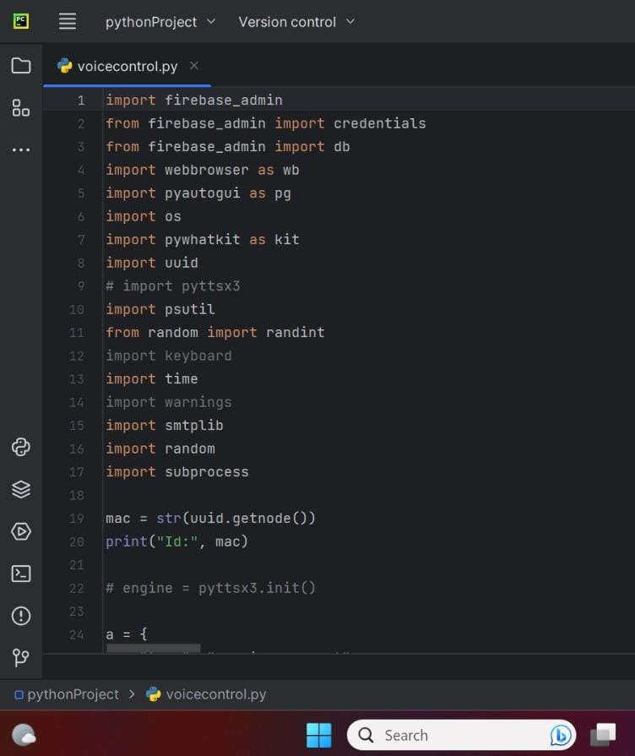
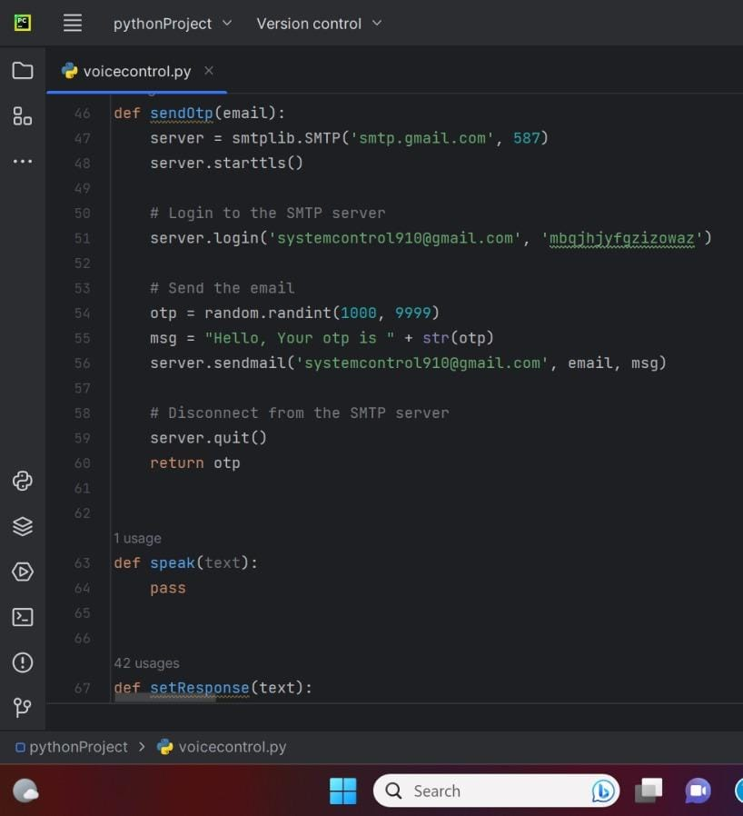
PROJECT CODE

Slide 24
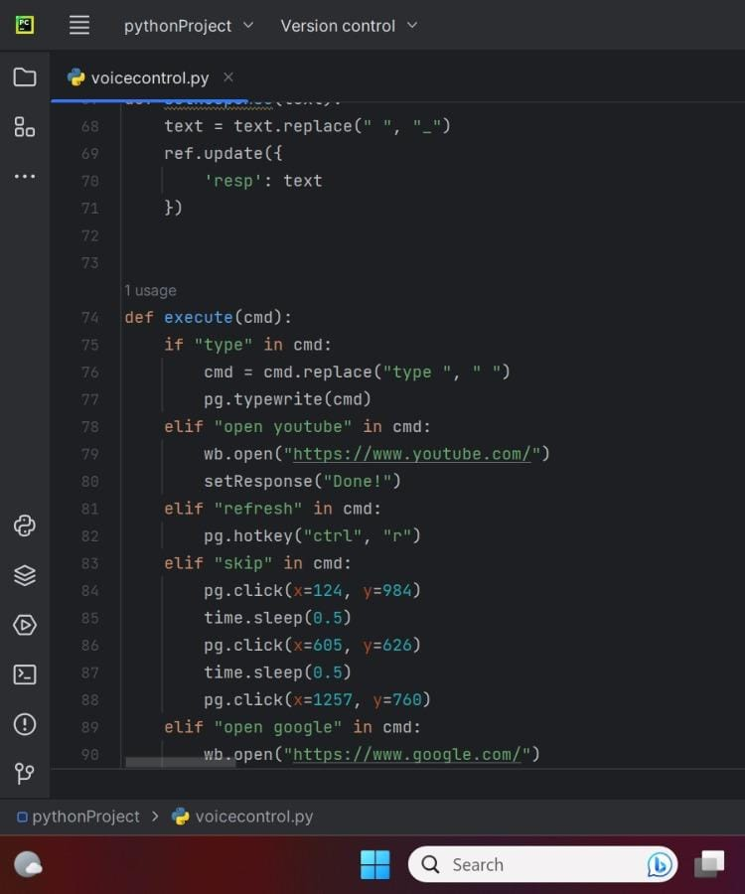
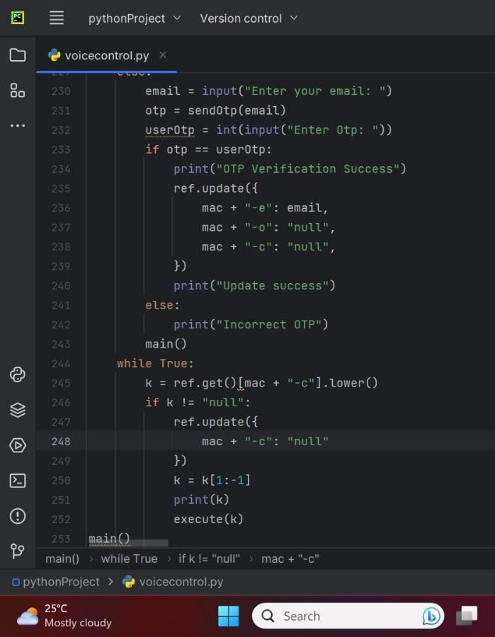
PROJECT CODE CONT…

Slide 25
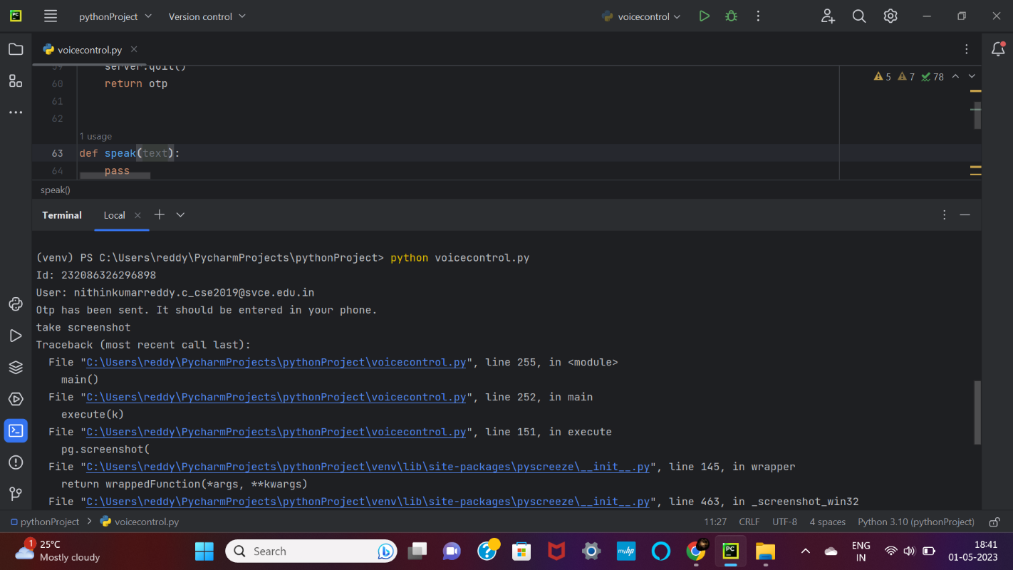
CODE TESTING
UNIT TESTING
Unit testing is a software testing method where individual units or components of software are tested in isolation from the rest of the software system to ensure they function correctly.

Slide 26
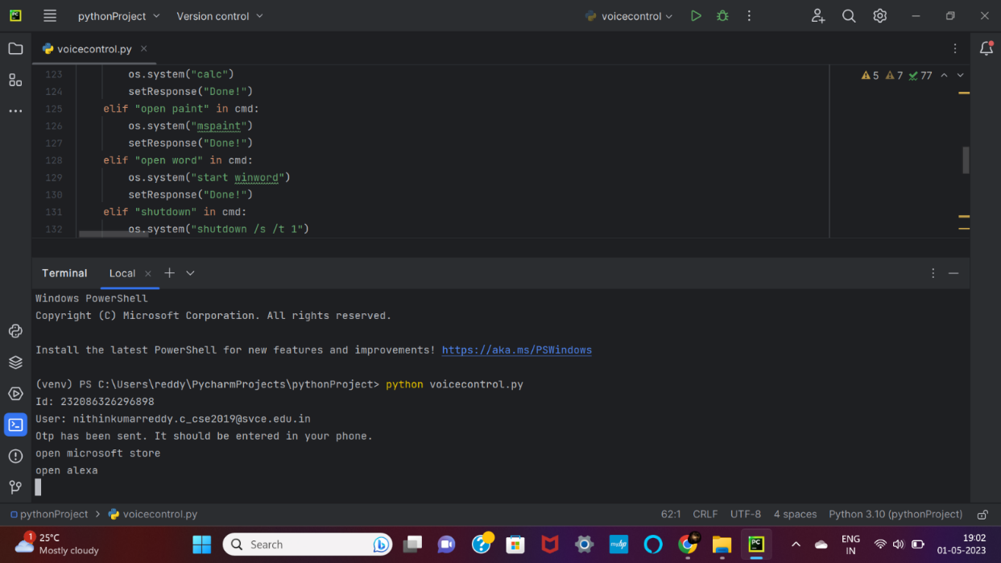
CODE TESTING CONT...
SYSTEM TESTING
System testing is a software testing method that tests the entire software system as a whole to ensure that it meets the specified requirements and functions correctly

Slide 27
TEST CASES MODEL BUILDING
CODE TESTING CONT...
Command Execution: Test the system's ability to execute commands based on voice commands received. This can be done by providing the system with voice commands and ensuring that it executes the appropriate command.
Error Handling: Test the system's ability to handle errors. This can be done by intentionally providing the system with incorrect or invalid voice commands and ensuring that it responds appropriately.
Security: Test the security of the system by ensuring that only authorized users are able to access and control the system.
Scalability: Test the system's ability to handle many users and commands. This can be done by simulating many users and voice commands and ensuring that the system is still able to respond appropriately

Slide 28
CONCLUSION
The proposed system presents an intuitive and easy way of controlling a computer system remotely using voice commands. The system uses a mobile interface built on Scratch, which captures the voice commands and transmits them to the remote computer system using Firebase. The remote computer system executes the commands received from the mobile interface. The system performs well under various network conditions and is an improvement over traditional socket-based connection.

Slide 29
REFERENCES
Sarikaya R: The technology behind personal digital assistants. IEEE Signal Process. Mag.34,67–81 (2017).
Tsiao J.C.S, Tong P.P, Chao D.Y : Natural-Language Voice-Activated Personal Assistant, United States Patent (10), Patent No : US 7,216,080 B2 (45), 8 May 2007
Sirbi K, Patankar, A.J : Personal assistant with voice recognition intelligence. Int. J. Eng.Res. Technol. 10(1), 416–419 (2017). ISSN 0974-3154
Lingyan Bi, Weining Wang, Haobin Zhong, Wenxuan Liu, "Design and Application of Remote-Control System Using Mobile Phone with JNI Interface", The 2008 International Conference of Embedded Software and Systems Symposia (ICESS2008), pp.416-419.2008
Reference Links
https://doi.org/10.1109/msp.2016.2617341
https://www.ijert.org/controlling-pclaptop-via-android-phone-android-remote-control
https://www.rroij.com/open-access/remote-access-to-pc-using-android-phone

Slide 30


